Slide 1
MOVIE TRAILER
WEBSITE
Home
About me
What I do
My experience
My work
MOVIELIST

Slide 2
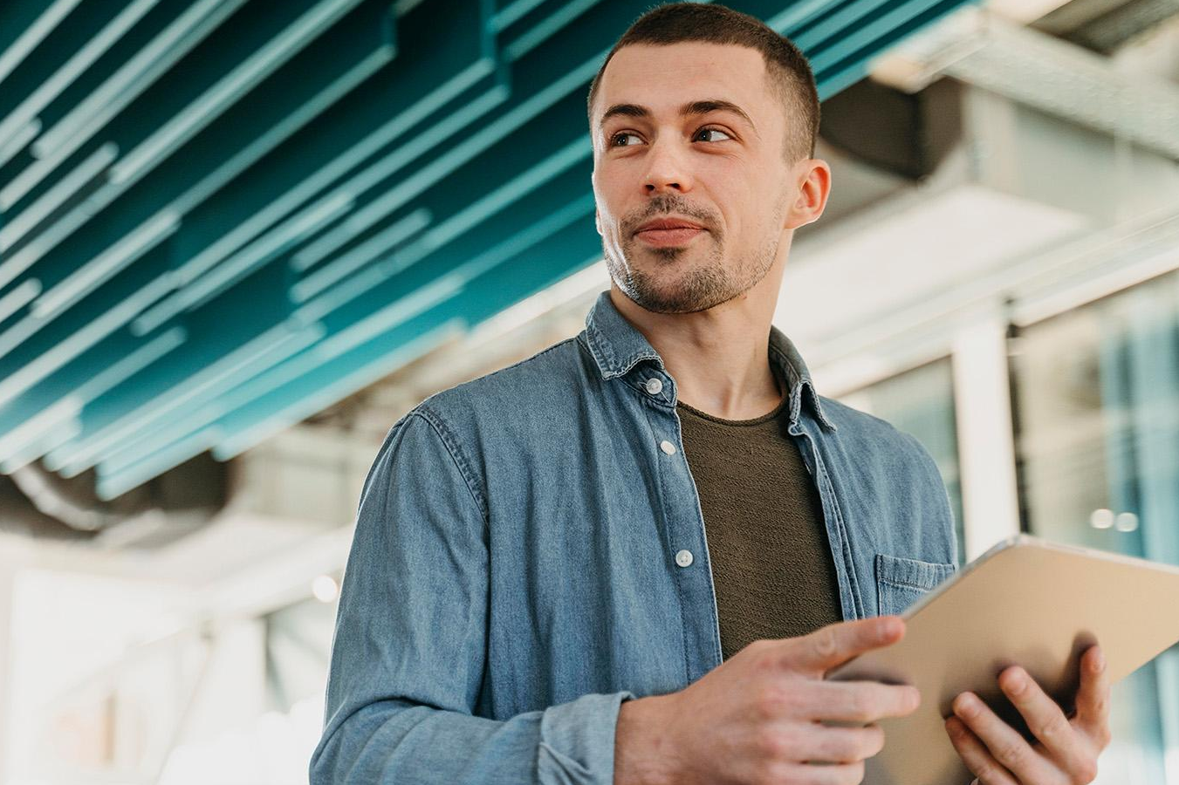
ANGGOTA KELOMPOK
Home
About me
What I do
My experience
My work
IRVAN RIZKY ARIANSYAH [ 202310015 ]
MUHAMMAD ILHAM [ 202310021 ]
NICHOLAS FICO [ 202310077 ]

Slide 3
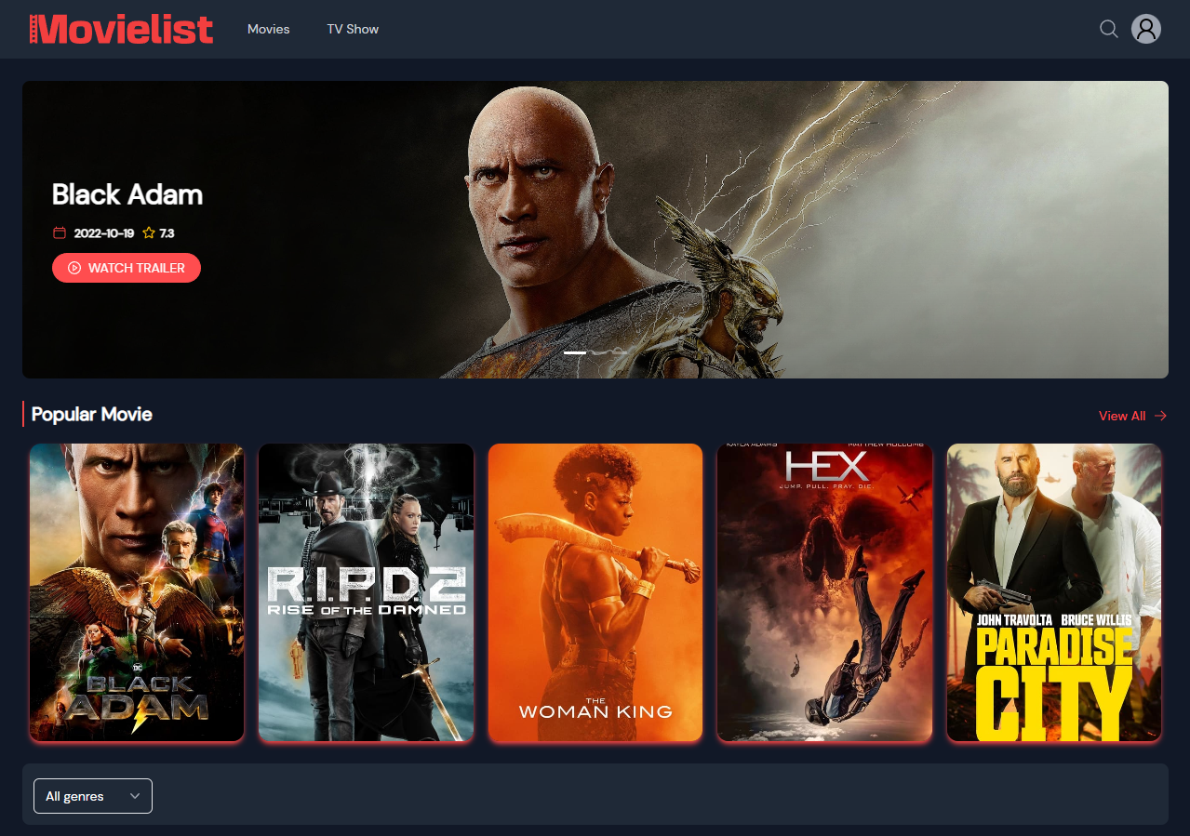
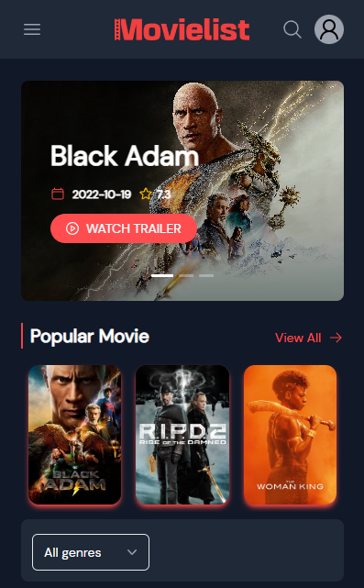
WEBSITE MOVIE TRAILER
Home
About me
What I do
My experience
My work
https://movie-web-react-js-02.vercel.app/

Slide 4
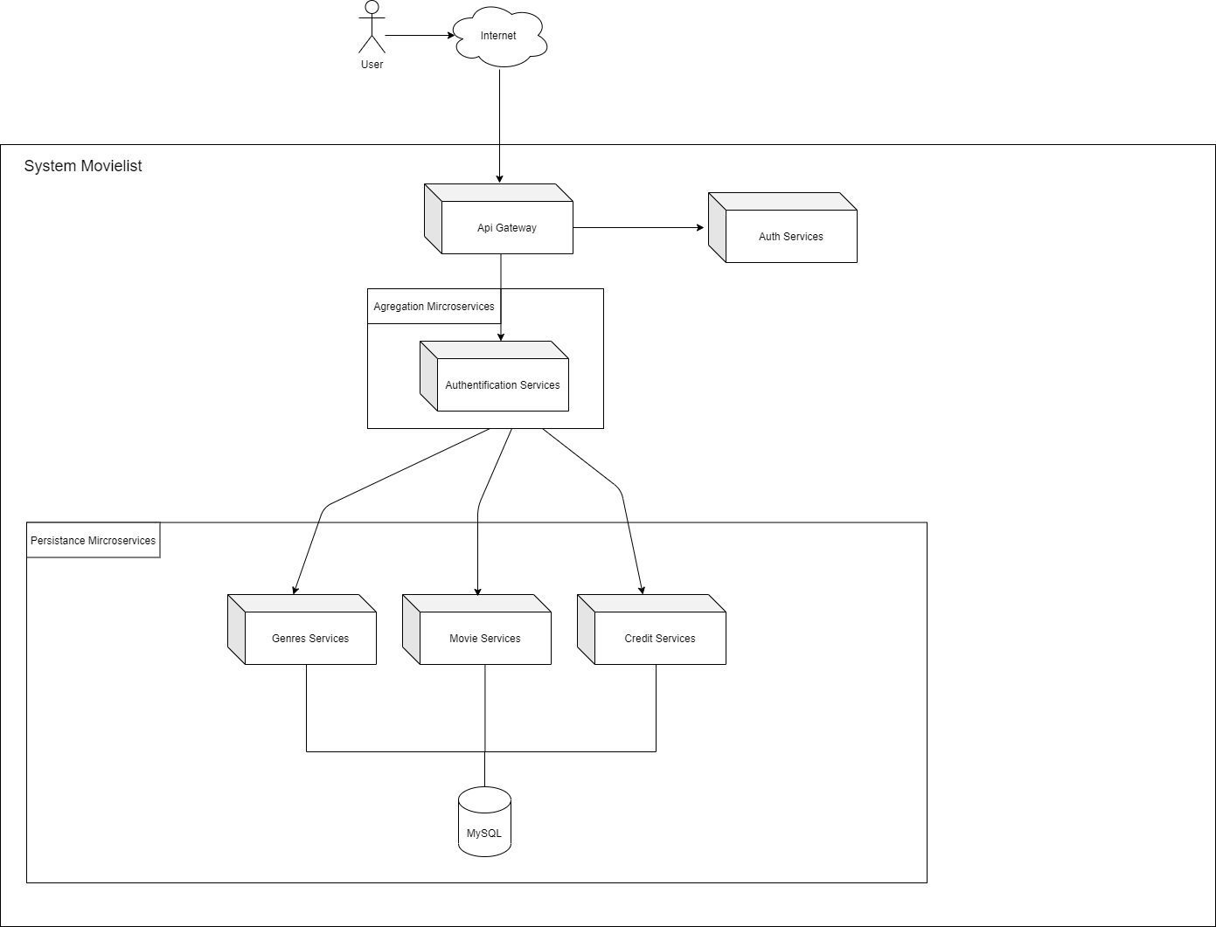
ARCHITECTURE SERVICES
02
03
04

Slide 5
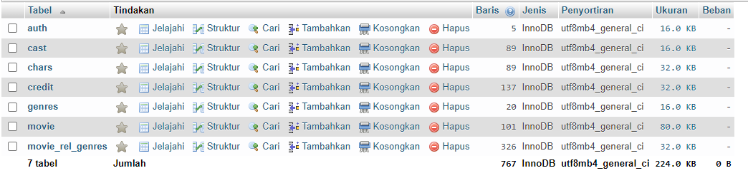
DATABASE
02
03
04

Slide 6
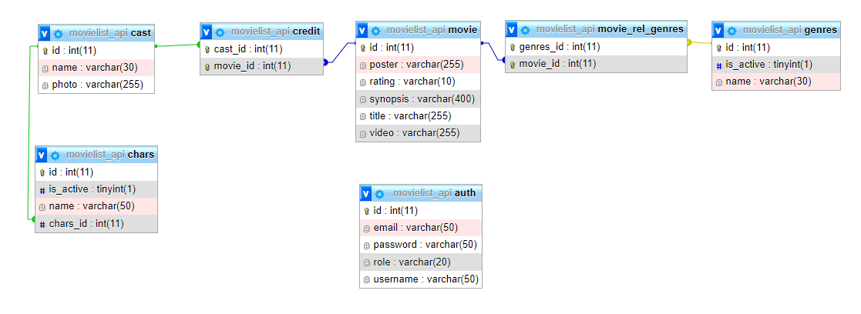
DESAINER DATABASE
02
03
04

Slide 7




TECHNOLOGY USED [ FRONTEND ]
01
REACT JS
02
TAILWIND
03
REDUX
04
AXIOS
01
02
03
04

Slide 8



TECHNOLOGY USED [ BACKEND - FRAMEWORK ]
01
SPRING BOOTS
02
JAVA
03
MAVEN
04
01
02
03

Slide 9

TECHNOLOGY USED [ BACKEND - DATABASE]
01
MySQL
03
04
01

Slide 10
THANK
YOU!!!
Home
About me
What I do
My experience
My work

